Slide 1
DFSMShsm Best Practices
Glenn Wilcock
wilcock@us.ibm.com
August 3, 2010
Session 8046

Slide 2
Legal Disclaimer
NOTICES AND DISCLAIMERS
Copyright © 2008 by International Business Machines Corporation.
No part of this document may be reproduced or transmitted in any form without written permission from IBM Corporation.
Product information and data has been reviewed for accuracy as of the date of initial publication. Product information and data is subject to change without notice. This document could include technical inaccuracies or typographical errors. IBM may make improvements and/or changes in the product(s) and/or programs(s) described herein at any time without notice.
References in this document to IBM products, programs, or services does not imply that IBM intends to make such products, programs or services available in all countries in which IBM operates or does business. Consult your local IBM representative or IBM Business Partner for information about the product and services available in your area.
Any reference to an IBM Program Product in this document is not intended to state or imply that only that program product may be used. Any functionally equivalent program, that does not infringe IBM's intellectually property rights, may be used instead. It is the user's responsibility to evaluate and verify the operation of any non-IBM product, program or service.
THE INFORMATION PROVIDED IN THIS DOCUMENT IS DISTRIBUTED "AS IS" WITHOUT ANY WARRANTY, EITHER EXPRESS OR IMPLIED. IBM EXPRESSLY DISCLAIMS ANY WARRANTIES OF MERCHANTABILITY, FITNESS FOR A PARTICULAR PURPOSE OR NON-INFRINGEMENT. IBM shall have no responsibility to update this information. IBM products are warranted according to the terms and conditions of the agreements (e.g., IBM Customer Agreement, Statement of Limited Warranty, International Program License Agreement, etc.) under which they are provided. IBM is not responsible for the performance or interoperability of any non-IBM products discussed herein.
Information concerning non-IBM products was obtained from the suppliers of those products, their published announcements or other publicly available sources. IBM has not necessarily tested those products in connection with this publication and cannot confirm the accuracy of performance, compatibility or any other claims related to non-IBM products. Questions on the capabilities of non-IBM products should be addressed to the suppliers of those products.
The provision of the information contained herein is not intended to, and does not, grant any right or license under any IBM patents or copyrights. Inquiries regarding patent or copyright licenses should be made, in writing, to:
IBM Director of Licensing
IBM Corporation
North Castle Drive
Armonk, NY 10504-1785
U.S.A.

Slide 3
Trademarks
The following are trademarks of the International Business Machines Corporation:
IBM, DFSMS/MVS, DFSMShsm, DFSMSrmm, DFSMSdss, DFSMSopt, DFSMS Optimizer, z/OS, eServer, zSeries, MVS, FlashCopy®
The information contained in this presentation is distributed on an 'AS IS' basis without any warranty
either expressed or implied, including, but not limited to, the implied warranties of merchantability or fitness for a
particular purpose. The use of this information is a customer responsibility and depends on the customer's ability to evaluate and integrate it into the customer's operational environment.

Slide 4
Agenda
Control Data Sets
Recall
Migration
Audit
Recycle
Tape
Throughput
Availability
Performance
Reporting
Miscellaneous

Slide 5
Control Data Sets
Record Level Sharing
To improve overall DFSMShsm performance, access the CDSs using Record Level Sharing (RLS)
Customers report significant performance improvements after switching to RLS
Actual customer data, Bank 1, comparing nonRLS and RLS, with 1 yr elapsed:
Actual customer, Bank 2, AUDIT before and after:
  Before: Couldn’t complete in 24 hrs
  After: Complete within 4 hrs
If you tried RLS and didn’t see an improvement, it is most likely a configuration problem
Function | Increase in GBytes moved | Decrease in Window size
Auto Backup | 33% | -25%
Migrate -> ML2 | 18% | -36%

Slide 6
Control Data Sets
GRS Star
Internal performance testing has shown a significant improvement in CDS I/O intensive functions when using GRS Star as opposed to GRS Ring
  GRS Star – A parallel sysplex implementation of Global Resource Serialization
    Resource name list is placed in the coupling facility so that any request for a resource can be resolved with a single interaction
  GRS Ring – A resource request must be passed to every participating member of the sysplex (ring)

Slide 7
Control Data Sets
CDS Reorg
Try to keep Reorganizing the CDSs to a minimum
  V1R12 CA Reclaim
CDS Performance will be degraded for 2-3 weeks after a REORG
  VSAM will perform a large number of CI / CA splits to create space for record insertions
  Don’t panic when HURBA / HARBA ratio increases during first few days
Use FREESPACE(0 0) so that VSAM can create free space where it is needed
Make sure all DFSMShsm hosts in HSMplex are shutdown
  This is one of the leading causes of breaking the CDSs
  Use DISP=OLD in REORG job to prevent DFSMShsm from starting,
  Or Rename the CDS.

Slide 8








Control Data Sets
Duplex CDS Backup Copies
Create disk backup copies in parallel using PIT copy
Use CB Exit to schedule a DFSMSdss dump job to create multiple copies of the disk backup copies
SETSYS EXITON(CB) CDSVERSIONBACKUP(DASD)
Onsite
MCDS
BCDS
OCDS
Journal
Backup
Offsite
MCDS
BCDS
OCDS
Journal
Backup

Slide 9
Control Data Sets
Health Checks / Journal Format
Enable DFSMShsm Health Checker checks
  HSM_CDSB_BACKUP_COPIES: Ensures that at least four CDS backup copies are being maintained
  HSM_CDSB_DASD_BACKUPS: When backing up to disk, ensures that all CDS Backup copies exist
  HSM_CDSB_VALID_BACKUPS: Determines if the number of valid backup copies has dropped below four
Allocate the journal as a Large Format Sequential data set if you have to back up the CDSs more than once a day due to the journal filling up

Slide 10
Control Data Sets
CDS Recovery
Keep journal and disk backups separate from MCDS, BCDS and OCDS
Minimize CDS Loss
  Dual Copy / Remote Copy
  Raid 5 or Raid 6
Have documented and Tested CDS Recovery Plans
Review “Data Recovery Scenarios” in DFSMShsm Storage Administration manual

Slide 11
Recall
Prioritization
RP Exit can be used to prioritize data set Recall, Delete and Recover requests
Priority range 0 – 100
  Default priority is 50
All Wait-type requests are prioritized higher than noWait-type requests
Recall and Delete requests are on the same queue
DSN: CUSTMR.DS1
Priority: 100
DSN: PROD05.DS1
Priority: 80
DSN: USERME.DS9
Priority: 50
DSN: UTIL01.DS2
Priority: 20
DSN: CLEANUP.DS7
Priority: 10

Slide 12
Control Data Sets
Common Recall Queue
NonCRQ environment – Each host processes own requests
ML2
Tape
HSM 1
ML1
DASD
ML2
Tape
ML1
DASD
ML2
Tape
HSM 2
ML1
DASD
ML2
Tape

Slide 13
Recall
Common Recall Queue (cont)
CRQ - All requests are placed onto a shared queue from which all hosts can select requests for processing
  Implemented using a Coupling Facility List Structure
ML2
Tape
HSM 1
ML1
DASD
ML2
Tape
ML1
DASD
ML2
Tape
HSM 2
CRQ
ML1
DASD
ML2
Tape

Slide 14
Recall
Common Recall Queue (cont)
Advantages of CRQ
  Workload balancing
  Tape mount optimization
  Quiesce Activity w/o impacting Recall
  Priority optimization
  Flexible configurations
  Request persistence

Slide 15
Recall
Common Recall Queue (cont)
Workload balancing
  Requests are evenly distributed among hosts until the maximum tasking level has been reached
HSM 1
HSM 3
HSM 2
CRQ
HSM 4

Slide 16
Recall
Common Recall Queue (cont)
Tape Mount Optimization
  A recall task will process all requests in the CRQ that require the same tape
  Only a single tape mount is required
T1
T2
T2
T1
T1
HSM 1
ML1
DASD
T1
T1
T1
ML2
Tape
T2
ML1
DASD
T2
ML2
Tape
T2
T1
T2
T2
T2
T2
T2
HSM 2
CRQ
ML1
DASD
T2

Slide 17
Recall
Common Recall Queue (cont)
Quiesce activity in preparation for a shutdown without holding Recall Activity
  HOLD CQ(RECALL(SELECTION))
  Places Recalls onto CRQ, but does not process any
HSM 1
HSM 3
HSM 2
CRQ
HSM 4
HOLD CQ(RECALL(SELECTION))

Slide 18
Recall
Common Recall Queue (cont)
Priority Optimization
  Highest priority requests in the HSMplex are processed first
100
100
60
HSM 1
100
HSM 3
100
90
100
20
100
50
10
50
90
90
20
10
HSM 2
60
HSM 4
50
20
60
10
CRQ
= Wait = Nowait 100 = Highest 0 = Lowest

Slide 19
Recall
Common Recall Queue (cont)
Flexible Configurations
  Hosts not connected to tape drives can be configured to only select non-tape requests
ML1
DASD
T1
T2
ML1
T1
HSM 1
T1
T1
T1
T2
T2
T2
ML1
T2
ML1
HSM 2
CRQ
ML1
DASD
HOLD RECALL(TAPE)

Slide 20
Recall
Common Recall Queue (cont)
Request Persistence
  Outstanding Recall requests from unavailable hosts are processed by available hosts
HSM 1
HSM 3
HSM 2
CRQ
HSM 4

Slide 21
Migration
Fast Subsequent Migration
Remigrating a data set to tape that was not updated since the Recall…
Without FSM
With FSM
1.Migrate
1.Migrate
X
->X
2. Recall
for Read
(no change)
2. Recall
for Read
(Keep a pointer to the location on tape)
4. Recycle
3. Remigration - Reconnect to Original Tape
5. Scratch Tape
3. Remigrate - Move to a new location

Slide 22
Migration
Fast Subsequent Migration (cont)
  Advantages
    No actual data movement for reconnection
    Recycle work load reduced
    SMS, nonSMS data sets supported
    Reconnection done automatically and is transparent to user
  DFSMShsm V1R7 updated this support to no longer rely on
  Data Set Change Indicator in VTOC to be OFF
  SETSYS TAPEMIGRATION(RECONNECT(NONE | ALL | ML2DIRECT))
  ALL – Reconnect when data is eligible for either ML1 or ML2
  ML2DIRECT – Only reconnect when data is eligible for ML2

Slide 23
Migration
Duplex Tape Error Handling
  SETSYS DUPLEX(MIGRATION(Y ERRORALTERNATE(CONT | MARKFULL)))
  For duplexing of migration tapes, both the original and the alternate will be marked full and two new tapes will be mounted
  Ensures that the original and alternate tapes are always identical
    Greatly reduces the need for Tape Copies
    No delay in creating the alternate copy
    Certain abends require a tape copy to be created

Slide 24
Migration
Management Class Values
  In the Management class, pay attention to “Primary Days Non-usage” and “Level 1 Days Non-usage”
  “Level 1 Days Non-usage” includes time spent on Primary
  Example
    Primary Days Non-usage = 4
    Level 1 Days Non-usage = 4
    This results in data sets being migrated directly to ML2 after 4 days
    In this case, “Level 1 Days Non-usage” should be ‘8’

Slide 25
Audit
Performance
IBM tape control units dramatically improve the performance of
AUDIT MEDIACONTROLS
  Implements a Hardware Assisted Search to improve performance
  Performance will vary depending on data set sizes on tape. Larger data set sizes get more benefit, smaller will get less.
  CPU utilization is drastically reduced since fewer blocks are read from tape
  IBM J70 tape control units or newer
    If required tape CU and microcode not available, then legacy AUDIT code is used

Slide 26
Audit
Mediacontrols
  Audit Mediacontrols can resume processing of migration or backup tape if:
    AUDIT MEDCTL of a volume is held
    DFSMShsm is stopped
    SETSYS EMERGENCY has been specified
  RESUME parameter of AUDIT MEDCTL VOLUMES(tapevolser) FIX command
    AUDIT cannot resume after ABENDS or I/O errors
  RESUME only valid when auditing a tape volume
  Valid only when FIX parameter is specified
  AUDIT MEDCTL VOLUMES(A00342) RESUME FIX ODS('HSM.FIX')

Slide 27
Recycle
Limiting Workload
Use the LIMIT parameter to match RECYCLE workload to your scratch tape needs:
  LIMIT(50): Process enough input tapes to return a net gain of 50 scratch tapes
  Example: Read 60 input, create 10 output
Use PERCENTVALID(0) to reclaim empty tapes when no drives available

Slide 28
Tape
VTS
In a VTS environment
  Disk backed by Tape:
    SETSYS PARTIALTAPE should be MARKFULL
    REUSE
      Causes the complete virtual volume to be staged when DFSMShsm reuses it
      Perhaps worse yet, it causes a ‘hole’ in the physical tape from which the virtual tape came
    MARKFULL
      Only used portion of virtual volume de-staged to back-end tape
      Does increase the number of virtual volumes required by DFSMShsm
  Disk only:
    SETSYS PARTIALTAPE should be REUSE
      Above issues do not exist

Slide 29
Tape
VTS (cont)
Volume size considerations
  Using a larger size (4GB)
    Multiple concurrent Recall requests from same volume are single threaded
      Can slow down overall throughput
      Reduces mounts, which is positive when the tape has moved to physical tape
    Multitasking RECYCLE may be limited if there are fewer larger tapes to recycle
    AUDIT and TAPECOPY/TAPEREPLACE are not multitasked, so no impact
    Reduce instances of reaching 40 volume limit

Slide 30
Tape
Connected Sets
Connected Set - sequence of tape volumes connected by valid spanning data
  Slows down recall and recycle activity
  More difficult for tape library ejections
You can minimize the occurrence of connected sets with the judicious use of SETSYS TAPEUTILIZATION(PERCENTFULL) and TAPESPANSIZE parameters
  Never use TAPEUTILIZATION(NOLIMIT)
  For TAPESPANSIZE, a larger absolute value is needed to represent the same amount of unused capacity on a percentage basis when the tape has a larger total capacity. eg:
    If you allow 2% of unused tape to avoid tape spanning for a 3590-Hxx device using enhanced media, you specify a TAPESPANSIZE of 1200 MB.
    To allow 2% unused tape for a MEDIA5 tape on a 3592 Model J device (no performance scaling), you specify a TAPESPANSIZE of 6000 MB.
    All size calculations for scaled tapes are based upon the scaled size and not the unscaled size.

Slide 31
Tape
Connected Sets (cont)
You can determine if you have connected sets by issuing
LIST TTOC SELECT(CONNECTED)
Consider use of the CHECKFIRST(N) parameter on generic RECYCLE command if significant number of connected sets that meet PERCENTVALID criteria are not being recycled
You can break a connected set by doing one of the following to the spanning data set
  Recall a migrated data set
  Deleting a data set backup using the BDELETE command

Slide 32
Tape
Collocate ML2 Data for ABARS
Collocate migrated data sets for same aggregate together to reduce mounts during ABACKUP
ML2
ABACKUP xyz
PROCESSONLY(ML2)
ABARS
Tape
ML2
ARECOVER AGG(xyz)
DSCONFLICT(REPLACE)

Slide 33
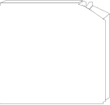
Fast Replication
HSM function that manages Point-in-Time copies
Combined with DB2 BACKUP SYSTEM, provides non-disruptive backup and recovery to any point in time for DB2 databases and subsystems (SAP)
Copy Pool Application
CP Backup Storage Group
Onsite
Offsite
FlashCopy
Dump to
Tape
Up to 5 copies and 85 Versions
Automatic Expiration
Multiple
Disk Copies
Recovery at all levels from either disk or tape!
Entire copy pool, individual volumes and …
Individual data sets

Slide 34
Fast Replication
DFSMShsm Advantages
New Source Volumes always included in backup
Copy Pool Backup Storage Group disallows allocations on target volumes
Managed creation/expiration of tape copies
DFSMShsm ensures valid tape copies
Data set level recovery from physical backup copies
Catalog capture during FlashCopy enables deleted data sets to be recovered
Managed retry of failed volume recoveries

Slide 35
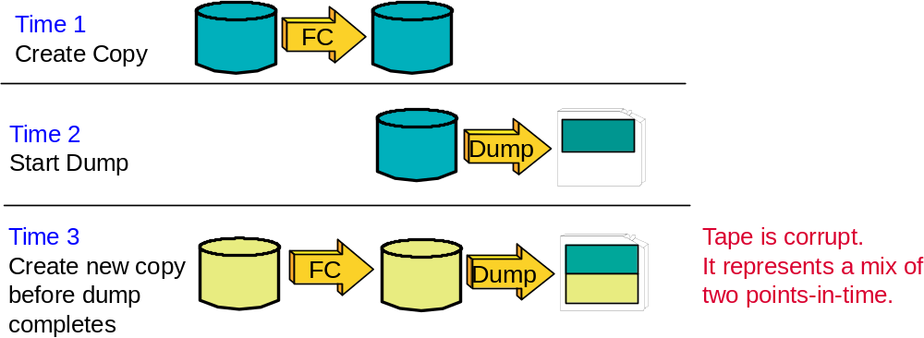
Fast Replication
Data Integrity
Scenario 1: Dump is in progress
DFSMShsm prevents this!

Slide 36
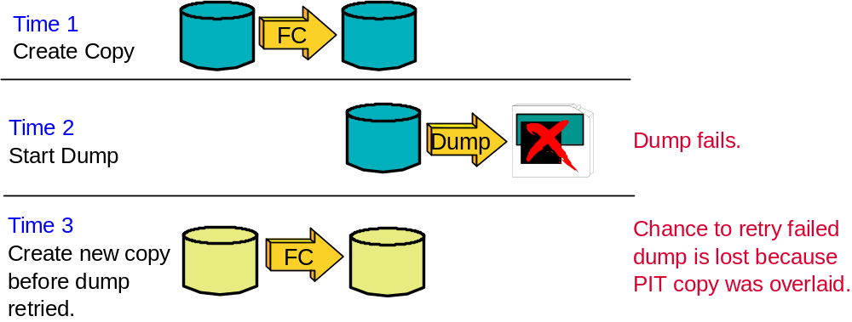
Fast Replication
Data Integrity
Scenario 2: Dump fails
DFSMShsm prevents this!

Slide 37
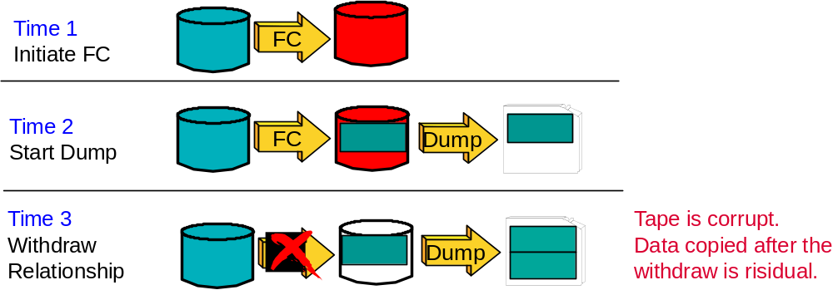
Fast Replication
Data Integrity
Scenario 3: Relationship is Withdrawn
DFSMShsm prevents this!
(When Withdraw done with DFSMShsm)

Slide 38
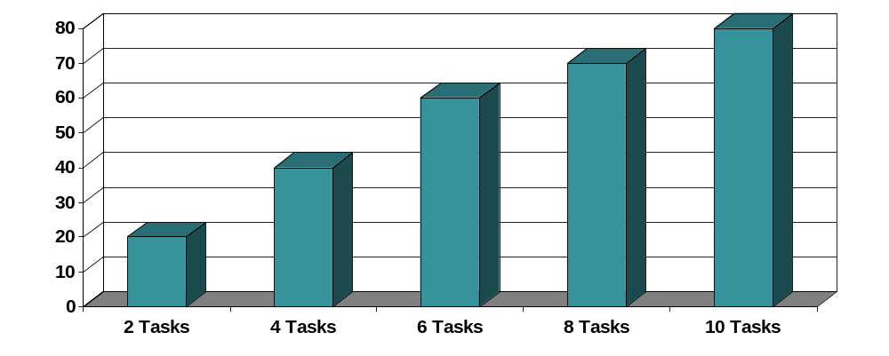
Throughput
MASH
In general, there is a performance ‘knee’ for DFSMShsm functions
i.e. – the average throughput decreases per task after a certain number of tasks have been started
  The knee for most functions is at 7-8 tasks
  For Fast Replication the knee is at 24 of the possible 64 tasks
Contention for the SYSZTIOT can be one cause

Slide 39
Throughput
MASH (cont)
Multiple Address Space HSM (MASH)
  Each LPAR can have multiple active DFSMShsm address spaces
  Up to 39 active DFSMShsms in an HSMplex
    HSMplex – All DFSMShsm’s sharing the same control data sets
Potential benefits of spreading out the DFSMShsm workload to more hosts
  Maintain tasks at optimal level
  Increase overall tasking level
  Hosts can be assigned different WLM Velocity Goals
  Recall hosts via Common Recall Queue
    Start hosts just to process Recall requests during high recall activity
  Reduces SYSZTIOT contention for disk/tape allocations
  Increased availability

Slide 40
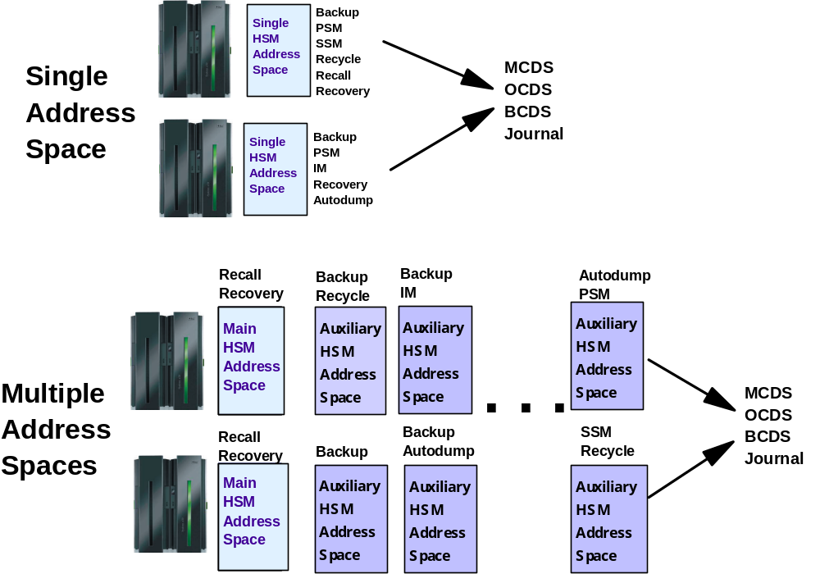
Throughput
MASH (cont)

Slide 41
Availability
Secondary Host Promotion
In an HSMplex, Secondary Host Promotion enables secondary DFSMShsm hosts to take over the unique functions being performed by a disabled Primary and/or Secondary Space Management DFSMShsm host
A Primary DFSMShsm host is the only host in an HSMplex that performs:
  Hourly space checks
  Automatic CDS backup
  Automatic movement of backup versions from ML1 to tape
  Automatic backup of migrated data sets
  Expiration of dump copies
  Deletion of excess dump VTOC copy data sets
There is generally only a single DFSMShsm host that performs SSM
Without SHP, when either the Primary or SSM host is disabled, the above functions are not performed

Slide 42
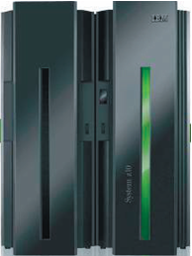
Availability
Secondary Host Promotion (cont)
X
HSMplex
HSM 1
Primary=Y
HSM 2
Primary=N
Promote=Y
HSM 3
Primary=N
Promote=Y
MCDS
BCDS
OCDS
Journal
Control Data Sets

Slide 43
Availability
Secondary Host Promotion (cont)
DFSMShsm host must be on a system within a HSMplex that has XCF active and configured in multisystem mode
SETSYS PLEXNAME(HSMplex_name_suffix)
  Default: ARCPLEX0
  Must be specified if more than one HSMplex within a sysplex. Must be specified on all hosts in that HSMplex.
  Must be specified in ARCCMDxx member
SETSYS PROMOTE(PRIMARYHOST(Y|N) SSM(Y|N))
  Default: No
  PRIMARYHOST(Y) is ignored for Primary host
  A SSM host cannot be promoted for another SSM host. ARC1521I issued if SSM(Y) specified on a SSM host

Slide 44
Availability
Cancel Active Tasks
Function enables hung tasks to be cancelled
  Reduces need to restart DFSMShsm due to a hung task
QUERY ACTIVE (TCBADDRESS)
  Requests only messages directly related to specific data movement activities be listed along with extra information allowing cancellation of the active task
CANCEL TCBADDRESS() or SASINDEX()
  TCBADDRESS - Address of TCB returned from Q ACTIVE
  SASINDEX - Index to be used when canceling an ABARS task
    Can be done instead of canceling the ABARS started task

Slide 45
Performance
SMF Consolidation Processing
Specify DDCONS(NO) on SMF parameters to avoid DD name consolidation during shutdown
  DDCONS is specified in SMFPRMnn parmlib member
  See MVS Initialization and Tuning Reference for more information
DFSMShsm is a started task with thousands of DD name allocations
DFSMShsm shutdown may be delayed up to 45 minutes if consolidation is performed
SMF Type 30 records are a bit longer

Slide 46
Performance
Avoid LOG Overhead
Use HOLD LOG to avoid DFSMShsm logging overhead
  Command can be added to PARMLIB
Turns off writing to the LOGX/LOGY data sets
Information available elsewhere, such as FSR records in SMF, Activity Logs, PDA trace data
Reduces DFSMShsm overhead activity
Some ISV products require the LOGX/LOGY data sets as input

Slide 47
Performance
Miscellaneous
Asynchronous scratch of migrated nonVSAM data sets
RECYCLE SYNCHDEV at intervals
Multitask Secondary Space Management
Overlap Phase 1 and Phase 2 of Volume Migration
No Recall on an IEFBR14 Delete and DELETE GDG FORCE

Slide 48
DFSMShsm Reporting
Report Generator
Generate reports of DFSMShsm functions and inventory using DFSMSrmm Report Generator
  DFSMSrmm Report Generator is an easy-to-use ISPF application
    Create and customize reports specific to your needs
    Available without a DFSMSrmm license
      New option on ISMF panel to create ‘Storage Management’ reports
    Sample Reports shipped in SYS1.SAMPLIB
DFSMShsm reporting based on
  DFSMShsm Function Statistics Record (FSR)
  DFSMShsm ABACKUP/ARECOVER Function Statistics Record (WWFSR)
  DFSMShsm Inventory (control data set) data via DCOLLECT

Slide 49
DFSMShsm Reporting
Report Generator
Migration Age of zero when data set is recalled
DFSMShsm Thrashing Report - 1 - 2008/02/04 15:06:18
DSN AGE SIZE KB MC NAME
-------------------------------------------- ---- ---------------- --------
HSMATH0.SMS.VBGPS1 0000 36830 MCLASS1
HSMATH0.SMS.VSMALNA 0000 159 MCLASS1
HSMATH0.SMS.VSMALNB 0000 159 MCLASS1
HSMATH0.SMS.VSMALNC 0000 159 MCLASS1
HSMATH0.SMS.VSMALND 0000 159 MCLASS1
HSMATH0.SMS.VSMALNE 0000 159 MCLASS1
HSMATH0.SMS.VSMALNF 0000 159 MCLASS1
HSMATH0.SMS.VSMALNG 0000 159 MCLASS1
HSMATH0.SMS.VSMALNH 0000 159 MCLASS1
HSMATH0.SMS.VSMALNI 0000 159 MCLASS1
HSMATH0.SMS1.PS.TEST0 0000 3 MCLASS1
HSMATH0.SMS1.PS.TEST1 0000 3 MCLASS1
HSMATH0.SMS2.PS.TEST2 0000 3 MCLASS1
Other fields included in the sample report:
Date; Elapsed time
Target volume
Return Code / Reason Code

Slide 50
DFSMShsm Reporting
FSRSTAT
FSRSTAT is a REXX sample program that reads DFSMShsm FSR records, and generates a statistical summary report
Shipped with DFSMShsm
  SYS1.SAMPLIB(ARCTOOLS)
Since it is written in REXX:
  Does not require any special programs or languages (SAS, MICS, etc.)
  It can be easily modified and customized to meet your needs
  It can be slow, consider running in batch using PGM=IKJEFT01
  Requires input data to be converted to RECFM=VB format

Slide 51
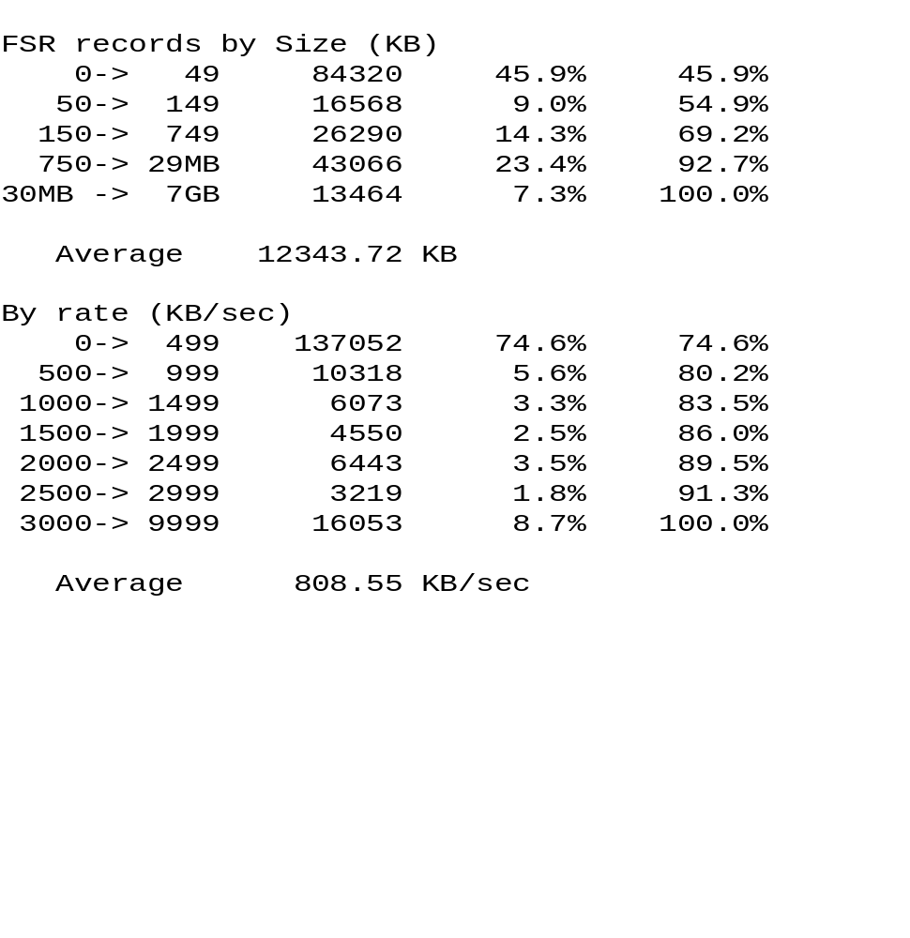
DFSMShsm Reporting
FSRSTAT
Nearly half!
Misleading
Smaller Data Sets
Larger Data Sets

Slide 52
Just For Fun
Penalize a user who continuously Recalls hundreds/thousands of data sets on a frequent basis by periodically moving all their requests to the bottom of the queues:
ALTERPRI USERID(anyuser) LOW

Slide 53
Summary
Improve performance
Work smarter
Exploit new functions
Exploit technology

